Slide 1
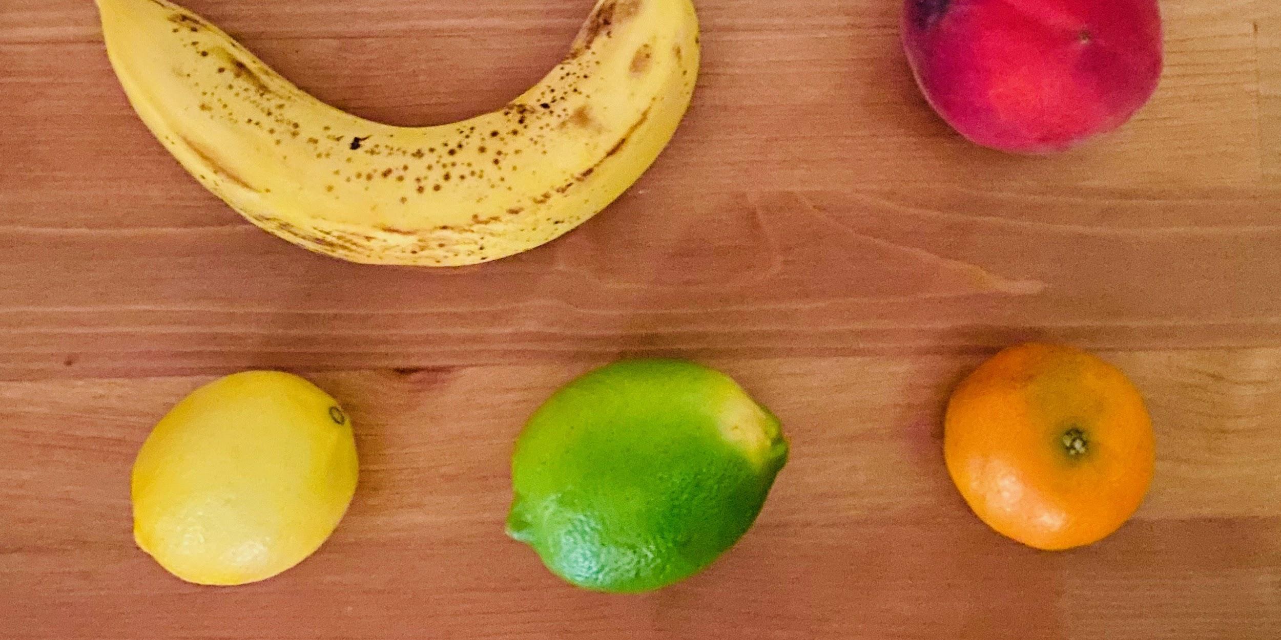
Intermediate Object-Oriented Programming with Java

Slide 2
Java Packages - Built-in packages
java.lang
java.util
String
Collection
Math
Queue
String
ArrayList
Integer
Example:
String.length(str)
Map
Long
.
.
.
.
.
.
** java.lang does not need to be imported

Slide 3
Java Packages - Name spaces
package.a
package.b
Record
Record
Okay if using fully qualified name:
package.a.Record
package.b.Record
Record if only one package is included

Slide 4
Java Packages - User-defined packages
com.skyroute66.petprofiler
Pet
Cat
Dog
Goldfish
PetProfilerUI

Slide 5
Java Packages - User-defined packages
com.skyroute66.petprofiler
com.skyroute66.pets
Pet
Cat
Dog
Goldfish
PetProfilerUI

Slide 6
Abstract Classes
com.skyroute66.pets
Pet
Cat
Dog
Goldfish

Slide 7
Abstract Classes
com.skyroute66.pets
Cannot be instantiated
Must be inherited
Pet
Cat
Dog
Goldfish

Slide 8
Abstract Methods
com.skyroute66.pets
Abstract method makeSound( )
(not implemented, cannot be called)
Pet
Cat
Dog
Goldfish
makeSound( ) {
Meow!
}
makeSound( ) {
Woof!
}
makeSound( ) {
Splash, splash!
}
Subclasses that are not abstract must implement it!

Slide 9
Static methods and variables
com.example.package
class myMath
static boolean isPrime(int x)
static int seed = 42
Famous example:
Math.round(x)
Use the class name, not the name of the instances
myMath.isPrime(5)
myMath.seed
No need to instantiate the class

Slide 10
Final methods
com.example.package
class myMath
final boolean isPrime(int x)
Subclasses CANNOT override and redefine
moreMath
@Override boolean isPrime(int x)

Slide 11




Interface - think of it as a treaty
Must export coffee!
We are in!
We are in!
Country A
Country B
COFFEE!!!
Icons provided by wanicon and freepik at flaticon.com

Slide 12
Interfaces
com.skyroute66.pets
Interface NoiseMaker
implements
method makeSound( )
Pet
Cat
Dog
Goldfish
makeSound( ) {
Meow!
}
makeSound( ) {
Woof!
}
makeSound( ) {
Splash, splash!
}
Because Pet is abstract and chooses not to implement it, first descendents that are not abstract must implement it. Otherwise, only Pet has to implement it.

Slide 13
Interfaces
com.skyroute66.pets
Interface NoiseMaker
implements
method makeSound( )
Pet
implements
Cat
Dog
Goldfish
Bee
makeSound( ) {
Meow!
}
makeSound( ) {
Woof!
}
makeSound( ) {
Splash, splash!
}
makeSound( ) {
Buzz!
}
Because Bee is not abstract, it will have to implement it and its subclasses do not unless they also choose to implement it themselves.

